Slide 1
Acids, Bases & pH
1 water molecule in 550 million naturally dissociates into a Hydrogen Ion and a Hydroxide Ion
Hydrogen Ion Hydroxide Ion
Acid Base
H₂O  H⁺ + OH⁻

Slide 2
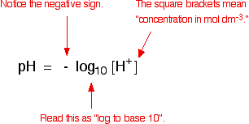
Biological Functions are Extremely
Sensitive to pH
pH is a measure of the concentration of hydrogen ions in a solution.
The lower the pH, the higher the concentration of hydrogen ions in the solution.

Slide 3
The pH Scale
Indicates the concentration of H⁺ ions
Ranges from 0 – 14
pH of 7 is neutral
pH 0 up to 7 → acid … H⁺
pH above 7 to 14 → base… OH⁻
Each pH unit represents a factor of 10X change in concentration
The pH value determines whether a solution is acidic, basic, or neutral:
  Neutral solutions have equal concentrations of OH⁻ and H⁺ and a pH of 7.
  Acidic solutions have a greater concentration of H⁺ and a pH of less than 7.
  Basic solutions have a greater concentration of OH⁻ and a pH of greater than 7

Slide 4
Calculating pH
The pH of a given solution expresses the negative logarithm of the hydrogen ion concentration, as represented in the following equation.
Example: The [H⁺] in a fruit juice was found 10⁻⁶ moles/liter. Calculate the pH of that solution. What is nature of that solution?
Because the negative logarithm (represented by the exponent in this equation) is three, wine pH = 6 and is therefore acidic.
Each pH unit represents a factor of 10X change in concentration
If pH changes by 2 units the H+ concentration changes by 10 X 10 = 100 times.
  Suppose the pH changes from 4 to 8, what is the
  change in H+ concentration?
  Suppose the H+ concentration goes up by a factor of
  1000, how much will the pH change?
pH = - log [H+]
[H+] = the H ion concentration in moles/liter

Slide 5
The pHs of common substances:
 | Approximate pH | Common Examples
Strong Acids | 0-2 | Stomach acid (HCl), battery acid (H₂SO4)
Weak Acids | 3-6 | Lemon juice, vinegar
Neutral | 7 | Pure water
Weak Bases | 8-11 | Bicarbonate solution
Strong Bases | 12-14 | Solutions of NaOH, KOH
Human blood pH is 7.4 – Mild Basic
Water pH is 7.0 -- Neutral
Gastric juice pH is 2.0 --- Strong acid

Slide 6
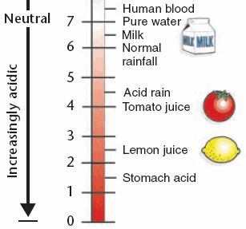
Acids
Substance capable of donating protons
Example: HCl, H₂SO₄
Strong Acid = pH 1-3
High in H⁺ ions
Lower number of OH- ions

Slide 7
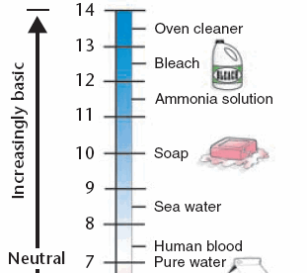
Bases
Substance that can accept protons
Examples: NaOH, KOH etc
Strong Base = pH 11 – 14
High in OH⁻ions
Lower in number of H+ ions

Slide 8
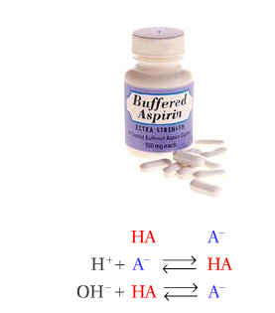
Buffers
Solution which resists changes in pH when small quantities of an acid or an alkali added to it.
involve a weak acid or alkali together with one of its salts.
Buffers keep the pH of body fluids stable.
They are part of homeostasis.
Biological Buffers:
In all multicelluar organisms, the fluid within the cell
(intracellular) and the fluids surrounding the cell
(Extracellular) have a characteristic and nearly constant pH.
Buffer systems exist to resists changes in pH in those
compartments.
Notes:
Control of pH is very important
Most enzymes function only within a very narrow pH
Control is accomplished with buffers made by the body
Buffers keep a neutral pH (pH 7)

Slide 9
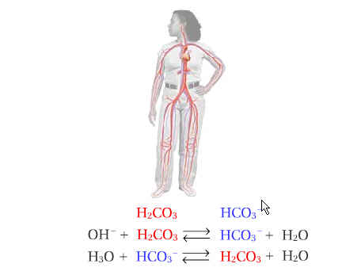
Buffers
Two important biological buffer systems:
  Phosphate buffer system (dihyrogen phosphate system)
  Carbonic acid and hydrogen carbonate
Carbonic acid and hydrogen carbonate: (H₂CO₃/HCO₃ – )
  Operates in blood to resist changes in blood plasma
Phosphate buffer system: (H₂PO₄– /HPO₄^{2–})
  – operates in the internal fluid of all cells.
  – consists of dihydrogen phosphate ions (H₂PO₄⁻) as
  hydrogen-ion donor (acid) and hydrogen phosphate
  ions (HPO₄²⁻) as hydrogen-ion acceptor (base).
  H₂PO₄⁻ (aq) H⁺ (aq) + HPO₄²⁻ (aq)
Notes:
These two ions are in equilibrium with each other as indicated by the chemical equation below.
H2PO4-(aq) H+(aq) + HPO42-(aq)

Slide 10
Properties of Liquids
Notes:
These two ions are in equilibrium with each other as indicated by the chemical equation below.
H2PO4-(aq) H+(aq) + HPO42-(aq)

Slide 11
Diffusion, Osmosis and Active Transport
Diffusion
  the process by which molecules move from an area of high concentration to areas of lower concentration.
  When two solutions of differing concentration (concentration gradient) are separated by a permeable membrane:
    The solute diffuses through the membrane from the solution
    having the greater solute concentration into the solution having
    the lesser solute concentration.
    Water (solvent) diffuses in to the solution having the greater solute concentration.
    This continues until the equality of concentration is achieved.
  Diffusion of particles is down a concentration gradient and causes homogeneous mixing.
Solute
Concentrated solution
Solvent

Slide 12
Examples of diffusion across concentration gradients in organism:
Place Particles move From To
Gut Digested Gut cavity Blood in
Food products capillary of villus
Lungs Oxygen Alveolar Blood circulating
air space around the lungs
In the lungs, the blood will continue
to take in oxygen from the alveolar
air spaces, provided that there is more
oxygen in the air spaces than in the blood.
The oxygen diffuses across the alveolar
walls into the blood.
The circulation takes
the oxygen-rich blood away and replaces
it with blood low in oxygen.
Blood in
Alveolar
Air in / out
Blood out
Air space
Exchange of oxygen across cell wall

Slide 13
Osmosis
  Some membranes in plant and animal cells allow certain particles to pass through them and not others.
  A membrane which is permeable to solvent and not to solute, is called a semipermeable membrane.
  Osmosis is simply a special type of diffusion - diffusion of water molecules through a partially permeable membrane into a solution having a higher solute concentration
  Osmosis is vitally important to plants. Plants gain water by osmosis through their roots.
Semipermeable membrane
Level rises
Solute molecules
Solvent molecules
Illustration of the process of osmosis
Concentrated
solution
Dilute solution

Slide 14
Artificial semipermeable membrane : cellophane, permeable to water but
not protein molecules.
Biological membrane : cell membrane
Osmotic pressure is the main cause of support in many plants. The osmotic entry of water raises the turgor pressure exerted against the cell wall, until it equals the osmotic pressure, creating a steady state.
When a plant cell is placed in a hypertonic solution, the water in the cells moves to an area higher in solute concentration, and the cell shrinks.
Osmosis is responsible for the ability of plant roots to suck up water from the soil.
In unusual environments, osmosis can be very harmful to organisms. For example, freshwater and saltwater aquarium fish placed in water of a different salinity than that they are adapted to will die quickly, and in the case of saltwater fish, rather dramatically.

Slide 15
Suppose an animal cell is placed in a solution of sugar or salt in water.
  If the medium is hypotonic — a dilute solution, with a higher water concentration than the cell — the cell will gain water through osmosis.
  If the medium is isotonic — a solution with exactly the same water concentration as the cell — there will be no net movement of water across the cell membrane.
  If the medium is hypertonic — a concentrated solution, with a lower water concentration than the cell — the cell will lose water by osmosis.
If a cell is put in a solution which is more concentrated than it's
own, then it will shrivel up, and if it is put in a solution less concentrated
than it's own, the cell will expand and burst.
H₂O
H₂O
H₂O

Slide 16
Isotonic solution
If the concentration of solute (salt) is equal on both sides, the water will move back in forth but it won't have any result on the overall amount of water on either side. "ISO" means the same.
Hypotonic solution
The word "HYPO" means less, in this case there are less solute (salt) molecules outside the cell, since salt sucks, water will move into the cell.
Hypertonic solution
The word "HYPER" means more, in this case there are more solute (salt) molecules outside the cell, which causes the water to be sucked in that direction.
In plant cells, the central vacuole loses water and the cells shrink, causing wilting.
In animal cells, the cells also shrink.
In both cases, the cell may die.

Slide 17
Osmotic Pressure
  osmosis may be opposed by increasing the pressure in the region of high solute concentration with respect to that in the low solute concentration region.
Therefore, Osmotic pressure is the force per unit area, or pressure, required to prevent the passage of water through a selectively-permeable membrane and into a solution of greater concentration.
Osmotic pressure is a colligative property, meaning that the property depends on the concentration of the solute but not on its identity.

Slide 18
Passive Transport - no energy is required for the molecules to move
into or out of the cell.
  Example : Diffusion and Osmosis
Active transport
  Active transport is the process by which dissolved molecules (solutes) move across a cell membrane from a lower to a higher concentration.
  In active transport, particles move against the concentration gradient - and therefore require an input of energy from the cell.
Sometimes solutes are at a higher concentration inside the cell than outside, but because the organism needs these substances they still need to be absorbed. For this the organism cannot rely on diffusion or osmosis alone. Carrier proteins pick up specific molecules and take them through the cell membrane against the concentration gradient.

Slide 19
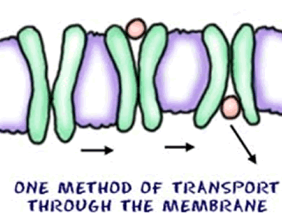
In Active Transport –
  As cells must move materials in an opposite direction - against a concentration gradient, it requires Energy.
Proteins or Pumps are found in the cell membrane transport molecules across the membrane.
proteins or pumps

Slide 20
Examples of active transport
In plants:
Plants need mineral salts (eg nitrates) for making proteins and growth.
Nitrates are at a higher concentration inside the root cells than they are
when dissolved in the water around the soil particles. If the plant relied
on diffusion alone, the vital nitrate salts would drain out of the cells into
the soil. So energy is deployed by the cells to actively transport nitrates
across the cell membrane into the root cells, against the concentration
gradient.
In humans:
Active transport takes place during digestion of food in the ileum (small
intestine). After food has been absorbed by the villi for some time, the
concentration of food molecules inside the villi increases, making it
impossible for more food to diffuse into the villi. So simple sugars,
amino acids, minerals and vitamins are actively absorbed into the villi,
from an area of lower to an area of higher concentration

